Slide 1
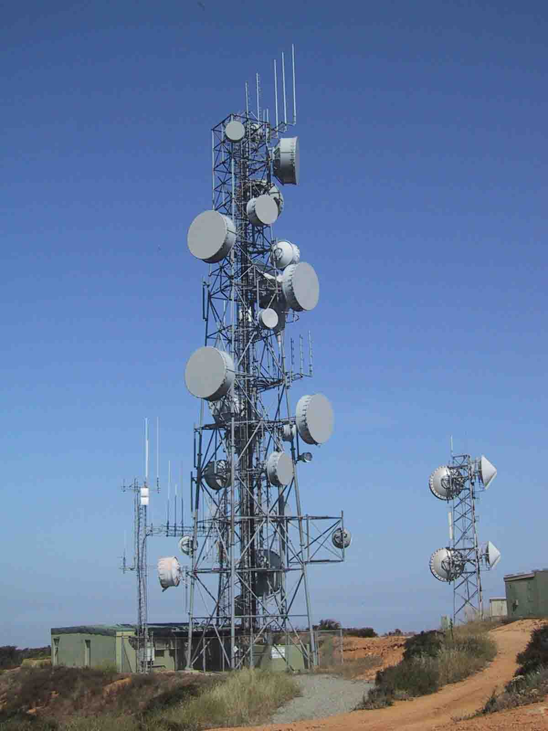
Master Control Talk Groups MCT’s Designed by: PNW/DCI Networks Mike Shirley – NO7RF NO7RF@trbo.org
Patrick Stewart – KA6P
Wrightwood, CA
capturecom@gmail.com
21 July 2018

Slide 2
What are MCTs ?
Special Group Call Talk Groups (TGs)
User commanded TG Control Method
Override default or normal settings & timers
Most or all TGs on a manager’s Time Slot (TS)
Semi-automatic method to avoid TG “hijacking”
Control TGs on TS 1 and/or TS 2 all via MCTs on TS 1
Not used for voice traffic

Slide 3
Why MCTs ?
Huge benefit to c-Bridge developers and admins
Eliminates need for individual hold-off timers
Coding of nn TS hold-off timers for each TG on the TS
nn = number of TGs on the TS
Example: 15 TGs in TS requires 15 timers for each of 15 TGs
225 hold-off timers total need to be coded in this example
MCTs only require 1 timer per TG
Development coding reduced from 6-8 hrs. to 1 hr. for a 15 TG TS
MCT use precludes TG hijacking by network traffic during local use

Slide 4
How is MCT Controlled?
TGIDs are created for MCT ON and MCT OFF
Example: Wrightwood DMR Repeater
MCT ON – TGID 16771811 (All TGs on Both TSs)
MCT OFF – TGID 16770811 (All TGs on Both TSs)
All MCTs are on TS 1 and can control TGs on either TS
Users enable the functions by kerchunking the appropriate MCT TG

Slide 5
How Does MCT OFF Work?
User kerchunks MCT “OFF” TG prior to making a call
C-Bridge turns OFF all TGs programmed for the function
User kerchunks the TG to be used: it becomes the only active TG
Selected TG remains protected from network hijacking for 15-29 minutes (c-Bridge programmable)
MCT OFF time targets average conversation duration
If activity exceeds the protection time, repeat MCT OFF
When activity ends, user can kerchunk a common TG
Repeater reverts to normal at end of MCT Timer

Slide 6
How Does MCT ON Work?
User kerchunks MCT “ON” TG at any time
Turns ON all TGs programmed for the function
Can include all Always Active and PTT TGs on all TSs
Repeater owner can specify ON function configuration
ON function stays active for 55-59 minutes
User can kerchunk MCT OFF and then select a common TG to be active
Or do nothing and let the MCT ON time out

Slide 7
What Else?
Local-1 and Local-2 can be programmed to function an MCT OFF command
This uses a shorter duration hold-off time of 5 minutes
Convenient when the user anticipates a short conversation

Slide 8
MCT Positives
Pro’s:
Simple for users to understand
TGs are either ON or they are OFF
Fewer competing timer interactions to confuse users
Can easily monitor nets without network contention
C-Bridge admin time is minimized by a factor of up to 16 times simply to program a new manager
Local-1 and Local-2 can act as MCT OFF, but shorter duration
MCT is in-use by many groups: mature and effective

Slide 9
MCT Negatives
Cons:
Less intelligent control dynamically during and between conversations
User should know and remember to initiate MCT OFF before making a call
May require the use of and space for the additional 1, 2, or 4 more TGs in a Zone (16-CH constraint)
It is a new approach and sometimes challenging for existing users to adapt

Slide 10
Summary
Great way to reduce c-Bridge development and maintenance time
Positive and substantial improvement
Users can control how they initiate and maintain TG access (or not)
Proven to work effectively and efficiently with minimal user learning curve
Targeted to c-Bridge developers and admins

